Slide 1
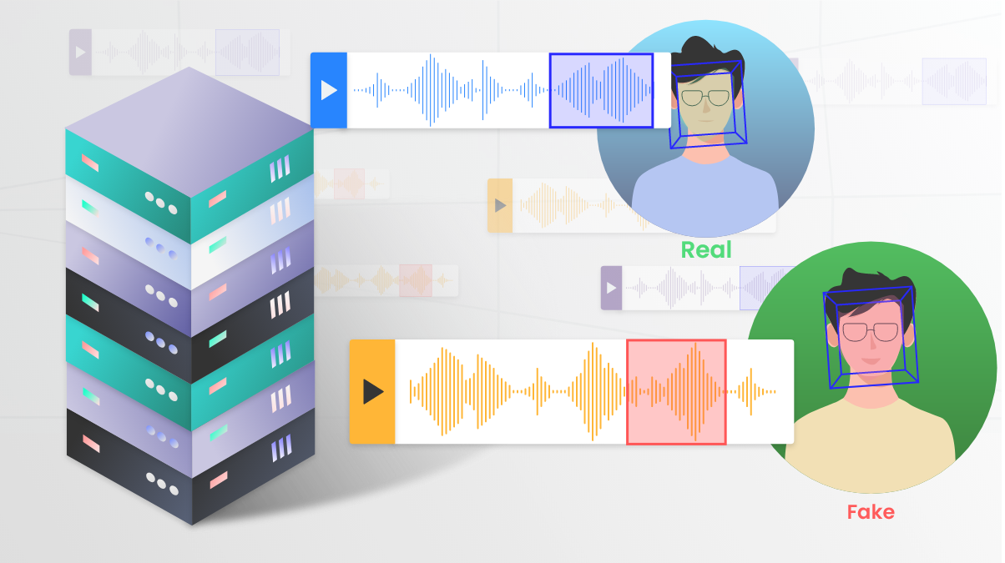
Defend DeepFake Audio & Audio Anonymization
Notes:
This slides is about the defend against DeepFake audio and audio anonymization

Slide 2
Content Overview
How To Defend DeepFake Audio
Look at the defend through 3 perspectives
Audio Anonymization Methods
Goes over anonymization method in detail and compare their effectiveness
DeepFake Audio Defend Methods
Goes over each defend method in details and compare their effectiveness
Relationship Between The Two
What is the difference, similarities between defend deepfake audio and audio anonymization
What Is Audio Anonymization
Potential risks associated with public sharing audio content and associated solutions
Summary
Summary of important points covered
Notes:
For the first part, 3 perspectives of defending against DeepFake Audio and the associated method
For the second part, audio anonymization and the associated method
Relationship between defending against DeepFake Audio and audio anonymization
Lastly, give a brief summary of the important points covered in the slides

Slide 3
How To Defend DeepFake Audio
Why Need To Defend Against DeepFake Audio
Generated Synthetic audio empower criminals for spam calls, fraud, fake news, impersonation of individuals
Prevention
How to prevent DeepFake technologies from extracting useful speaker voice biometric to do voice cloning
Speaker Anonymization
Feature-based Approach
Image-based Approach
Human-Machine Difference Approach
Detection and Labelling
Detection
How to detect whether the given audio sample is DeepFake created or not
Reaction
How to raise individual’s awareness in aspects like to be more careful with information leaks and audio information encountered
Security Training Program
Secure Digital Profile
Notes:
Deepfake Audio generation techniques are able to imitate person’s speech, generate believable voice clips using only second long samples.
These generated audio can be a form of speech synthesis or voice cloning
Capable of empowering criminals for spam calls, financial fraud, creating fake news, create fake voice clips for impersonation of either celebrities, politicians or individuals
Thus, this lead to the first main topic: how to defined against DeepFake Audio
We can look at this through 3 perspectives
Firstly, Secondly, Thirdly
For prevention, cover the method of speaker anonymization
For detection, cover 3 approaches follow with a comparison
For Reaction, cover both from organizational level and from individual level

Slide 4
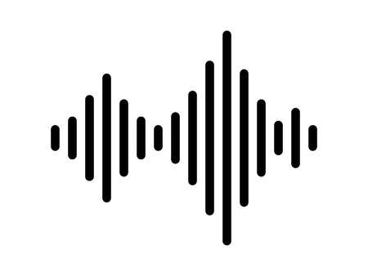
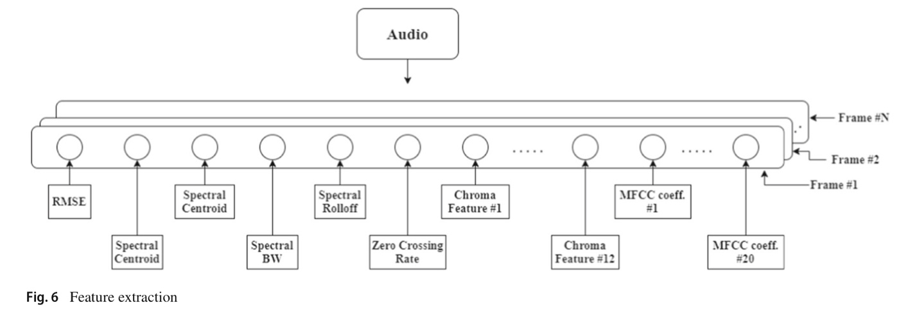
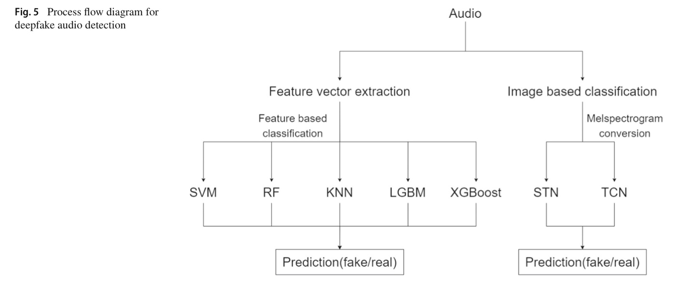
DeepFake Audio Defend Methods – Detection Feature Based Approach
Step 1.
Convert the audio file into the digital form of the audio file : a time series of the sampling rate
Step 1,2 utilize librosa: a python package
Step 3.
Feed the 37 spectral features into the machine learning algorithms for the classification of audio as fake or real
SVM: Support Vector Machine
RF: Random Forest
KNN: K-Nearest Neighbors
LGBM: Light Gradient Boosting Machines
XGBoost: Extreme Gradient Boost
Hyperparameter Optimization: GridSearchCV
Step 2.
Extract 37 spectral features of the audio as a vector by performing feature vector extraction
Notes:
Deepfakes are getting better as technology advances and it is hard for human ears to identify the nuances between human-generated speech and machine-generated or alternated speech. In order to defend against Deepfake Audio, users can run the audio content through a deepfake detector, let the detector determine whether the audio is a Deepfake or not^{[1,3]}
Get into the first detection approach: feature based approach
The general idea of this approach Convert audio file into a feature-based dataset consisting of various spectral features of the audio sample
And input these features to train machine learning algorithms to do classification

Slide 5
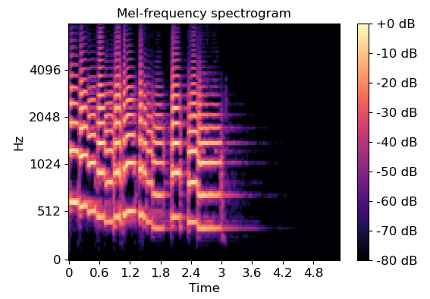
DeepFake Audio Defend Methods – Detection Image Based Approach
Step 1.
Convert the audio samples into melspectrograms
Melspectrograms
Graphic representation of signal strength in terms of signal’s intensity
Shows frequency variation of acoustic signals with respect to time
Step 2.
Input the melspectrograms into deep learning algorithms for classification
CNN: Convolutional Neural Networks
STN: Spatial Transformer Network
TCN: Temporal Convolutional Network
Notes:
The second detection approach: image based approach
The general idea of this approach Convert audio file into melspectrograms
and input these graphic representation of audio files to deep-learning algorithms for classification

Slide 6
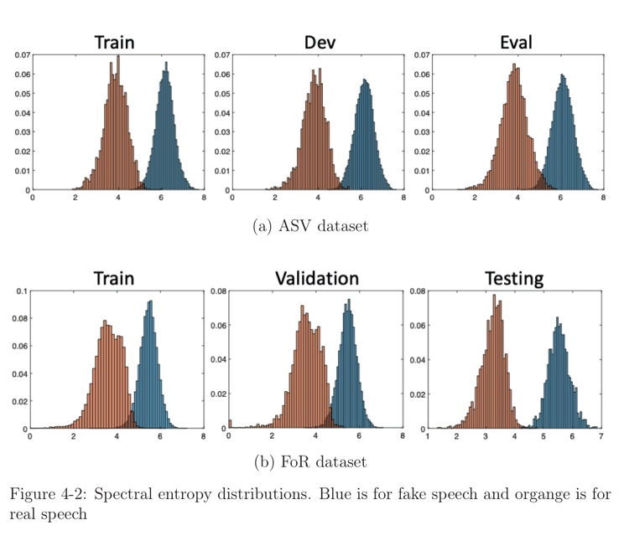
DeepFake Audio Defend Methods – Detection Human Machine Difference Approach
Characteristics of human Speech
Pitch, Formant, Jitter, Zero Crossing Rate
Inhalation sounds, breath sounds
Spectral Entropy of F0 Sequence
Based on comparison, the spectral entropy of F0 sequence is a good indicator that captures statistical difference between speech and natural speech across datasets
F0 sequence is trimmed to remove the zero values at the beginning and end of the sequence and then plotted the spectral entropy distribution
Spectral entropy is the spectral power distribution, is a measure of signal irregularity
Notes:
The third detection approach focuses on the differences between human-generated and machine-generated speech
Talk about Characteristics of human speech
Many features can be extracted from voiced and unvoiced speech:
Pitch : high/low of the sound
Formant: frequency range, reflects sound special quality
Jitter: slight unsteadiness in voice/sound
Zero crossing rate: the rate at which a signal changes from positive to zero to negative or from negative to zero to positive
Inhalation sounds are generally more natural and less affected by voluntary influences: breath sounds can be used as bio-signitures to identify speakers
Idea of this approach is based on Features that capture the fine-level inconsistencies and nuances of the speech production process could consistently exhibit differences between synthetic speech and genuine speech
Results show that spectral entropy of F0 sequence is a good indicator that captures statistical difference between synthetic speech and natural speech across datasets
- Proposed global modulation feature model Used CNN as the base and input the spectrol entropy features for training the model

Slide 7
DeepFake Audio Defend Methods – Detection Evaluation Metrics
Equal Error Rate (EER)
Biometric performance – verification task
Lower the better
Precision
Confusion matrix
Precision = TP/ TP+FP
Tandem Detection Cost Function (t-DCF)
Detection Cost Function
Spoofing Countermeasures/Automatic Speaker Verification
Recall
Confusion Matrix
Recall = TP/ TP+FN
F-Score
Measure of model’s accuracy on data
Binary classification systems
Test Accuracy
On data that id not used for training
Notes:
Before get into the comparison of these approached
ERR: A statistic used to show biometric performance, typically when operating in the verification task. In general, the lower the equal error rate value, the higher the accuracy of the biometric system.
Tandem detection cost function (t-DCF) ^{[13]} : a Detection Cost Function for the Tandem Assessment of Spoofing Countermeasures and Automatic Speaker Verification ^{[14]}
Test accuracy : on data that did not use for training
Precision = TP/TP+FP ^{[8]}
Based on Confusion matrix ( True/False) (Positive/Negative)^{[8]}
Measurement of ability to classify positive samples in the model^{[8]}
If the goal is to classify all as well as negative samples as positive^{[8]}
Recall = TP/TP+FN^{[8]}
Measurement of how many positive samples were correctly classified by model^{[8]}
If goal is to detect only all positive samples^{[8]}
F-score
Measure of model’s accuracy on a dataset^{[9]}
Used to evaluate binary classification systems (positive/negative)^{[9]}
A perfect model has an F-score of 1^{[9]}

Slide 8
DeepFake Audio Defend Methods – Detection Comparison of Approaches
Approach | Model | Test Accuracy
Feature Based Approach | SVM | 0.67
 | RF | 0.62
 | KNN | 0.62
 | XGBoost | 0.59
 | LGBM | 0.6
Image Based Approach | TCN | 0.92
 | STN | 0.8
Spectro-temporal Feature | CNN | 0.9-0.98
Conclusion
Image-based classification approach is better
Image-based features and distributions serves as better features.
Highest Accuracy 92% - 98% in use of global modulation feature and CNN based approach
Labelling
The voice should be labeled is something is detected as being manipulated
No trusting source
Trusty
Notes:
The more detailed evaluation of each approach can be found in associated papers
The most direct measurement: test accuracy
Detection and Classification serves as the first step.
Then we can perform content labelling
Items that are classified as Deepfake should be labeled with Deepfake or other information. It should be clear to the viewer that the content has been significantly modified or not
Items that has no trusted source or has not been tested should also be labelled clear, that the content is not known whether trusty or not. So the viewers are being remined to be more careful with the information received
Item that passed the classification detection model can be labeled as trusty.
This wraps up the section of detection methods

Slide 9

DeepFake Audio Defend Methods – Reaction Security Training Program
Educate Employees for Verification Process
Attackers infiltrates the organization/company/ account by having the user click on malicious link
Enforce strict verification procedure
Practice verification even when recognize someone’s voice
Properly answer identify and react to suspicious calls
Sending a message through collaboration system for verification
Evaluate the Effectiveness
Test employees by having them receive live calls from trained professionals who can emulate the tactics of real attackers
Notes:
The next perspective is reaction, How to raise individual’s awareness in aspects like to be more careful with information leaks and audio information encountered
The organization/company level
In order to access personal data for stealing private audio data of individuals, attackers sometimes infiltrates the organization/company/account by having the user click on malicious link (email, social media direct message, text message)^{[2.}
The organization should Educate employees for the verification procedure^{[1]}
Engineers can develop and implement security training program^{[2,6]}
Train employees to properly answer, identify and react to suspicious calls^{[2],} Practice for verification when recognize someone’s voice or face
The security training should include identifying modern tactics like deepfakes and mobile phishing – especially while people work remotely. Since they can’t walk down the hall to validate communication from a co-worker, to encourage employees to reach out over different channels.^{[6]}
Such assending a message through a collaboration system to verify that an unusual phone call was legitimate or not^{[6]}

Slide 10

DeepFake Audio Defend Methods – Reaction Secure Digital Profile
Secure Digital Profile
Keep software up to date (Security Updates
Routinely check privacy settings
Account Security: Multifactor authentication
Be careful with website navigation
Check validity of callers
Individual Awareness in Data Protection
Limiting public presence on social media
Enabling privacy restrictions
Prevent scammers from easily stealing your voice
Notes:
Never navigate to a website from phone call or email link (check validity)^{[2]}
Check validity of callers (Solution: request the caller’s email address to send a email to check their identity, it can be similar to what websites has done, after entering correct password, they would send a security code though text, phone call or email)^{[2]}

Slide 11
What is Audio Anonymization
Why Need Audio Anonymization
Risk 1: Identity Privacy Breach
Risk 2: Speech Content Privacy Breach
Speaker Anonymization
How to remove or modify the voice biometrics of a speaker in an audio sample
Voice Conversion
Blur Method
Speech Content Desensitization
How to remove or modify the sensitive content in speech/conversations in an audio sample
Blur Method
Detect and Replace sensitive keywords
Notes:
Before covering the prevention method of defending deepfake audio
I will first go over audio anonymization, and the overlap between the two would be very clear
Privacy Risks
Identity privacy breach: Attacker would be able to train voice models of this person based on speech samples, attackers may extract voiceprints and generate fake speeches that sound like us through speech synthesis and voice cloning
Speech content privacy breach: Attacker can analyze the speech content and learn more detailed information about the person
For Risk 1:
For Risk 2: perform

Slide 12
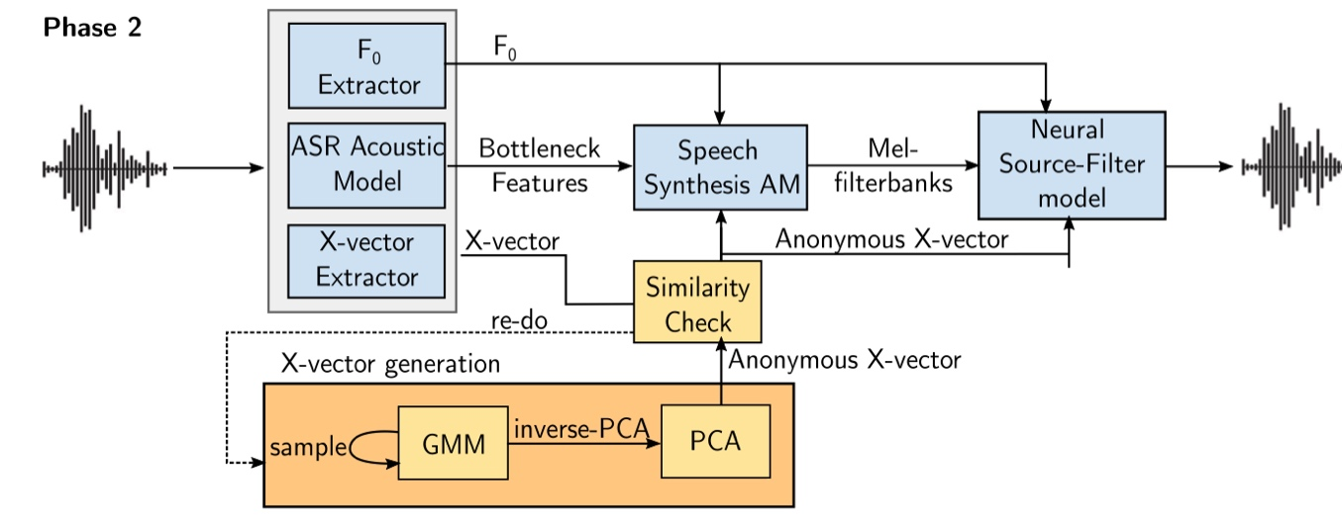
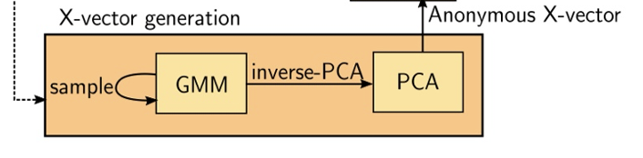
Speaker Anonymization – Voice Conversion GMM-PCA
Step 1.
Derive 3 components from the audio
X-vector extracted by TDNN(Time delay neural network) which represents the identity of the speaker (voice biometric)
The bottleneck features obtained by applying an automatic speech recognition acoustic model
Pitch Information (F0)
Step 2.
Generate a pseudo x-vector
Learn the properties of x-vector space using PCA (Principle Component Analysis
Fit a generative model on the reduced space using GMM(Gaussian Mixture Model)
Step 3.
Use a speech synthesis module: F0, BN features and the pseudo x-vectors to generate melspectrograms, output mel-filterbanks
NSF model process these filterbanks along with F0 and pseudo x-vector to generate anonymized audio
GMM: a probabilistic model that assumes all the data points are generated from a mixture of a finite number of Gaussian distribution with unknown parameters
PCA: PCA maps original data matrix onto an orthogonal space and let us extract a set of factors and then select a subset of those factors, reduce the dimensionality of the problem, those factors are the principle components (PCs) extracted through PCA)
Notes:
There are 3 models assoiated with voice conversion

Slide 13

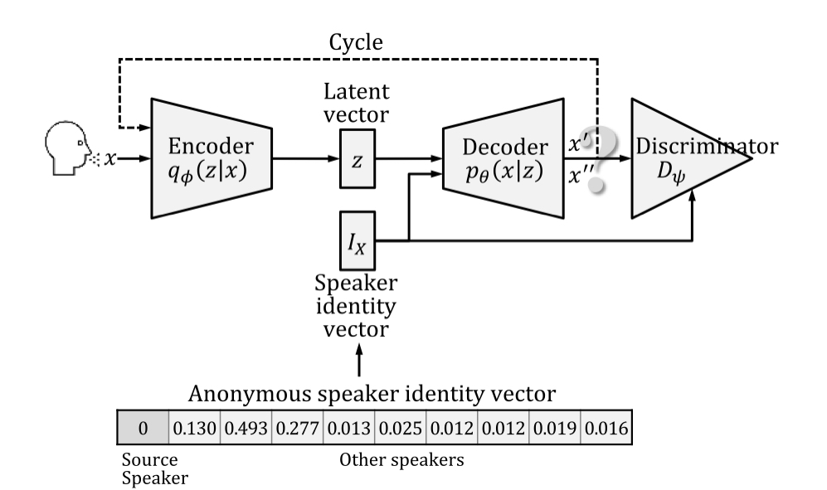
Speaker Anonymization – Voice Conversion CycleVAE-GAN
Variational Autoencoder (VAE)
The model receives x as input
The encoder compresses it into the latent space
The decoder receives the information sampled from the latent space and produce x’, the decoder aims to make x’ as similar as possible to x
the encoder is trained to extract latent vector z (contains the linguistic information of the input speech)
the decoder is trained to reconstruct the input speech from the latent vector z and the source speaker identity I­_{X}
Anonymous Speaker Identity Vector:
is fed into the decoding process of the VAE to convert the source speaker speech to the anonymous speaker speech
Uniform values: 1/(n-2), 2/(n-1)
Non-uniform values: k-fastest speaker, cosine similarity
Generative Adversarial Network (GAN)
The decoder of the VAE is considered as the generator of the GAN
The discriminator of GAN helps the generator (VAE decoder) to produce a speech similar to that of the target speaker
Notes:
Use uniform values
As in b) assign 0 to the source speaker and assign the value of 1/(n-1) to other speakers uniformly in the anonymous speaker identity vector
As in c) assign -1 to the source speaker and assign the value of 2/(n-1) to other speakers uniformly in the anonymous speaker identity vector
As in d) assign -1/(n-2) to the source speaker and 1/(n-2) to the other speaker
All leads to summation of 1: the decoder of the VAE is trained to handle a speaker identity vector is a unit vector
As in a) use the cosine similarity of each pair of vectors
As in b) use the inverse of the cosine similarity values, setting the source speaker value to 0 and normalizing the values to obtain a sum of 1
Determination of k-farthest speakers and uniformly assigning the value of 1/k to them and 0s to others:
C) one-farthest speaker is set to 1 and others are set to 0
D) two-farthest speaker is set to 0.5 each and other are set to 0
When the speaker identity vector being replaced with an anonymous speaker identity vector, the speech can be anonymized

Slide 14
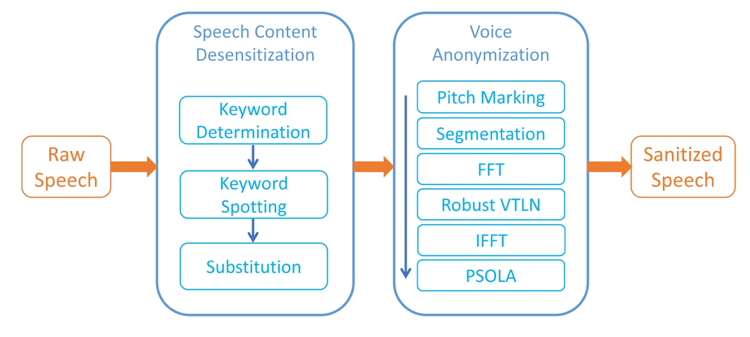
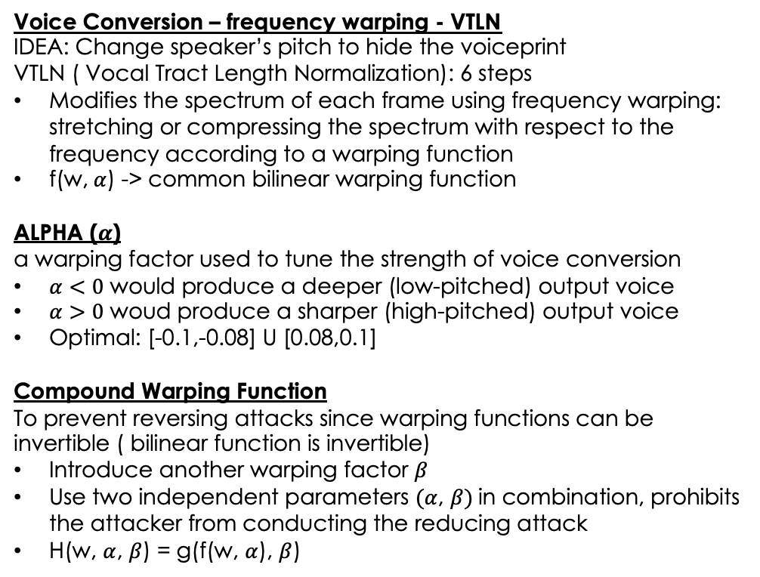
Speaker Anonymization – Voice Conversion
Pitch Modification
Voice Conversion – frequency warping - VTLN
IDEA: Change speaker’s pitch to hide the voiceprint
VTLN ( Vocal Tract Length Normalization): 6 steps
Modifies the spectrum of each frame using frequency warping: stretching or compressing the spectrum with respect to the frequency according to a warping function
f(w, $α$) -> common bilinear warping function
ALPHA ($α$)
a warping factor used to tune the strength of voice conversion
$α<0$ would produce a deeper (low-pitched) output voice
$α>0$ woud produce a sharper (high-pitched) output voice
Optimal: [-0.1,-0.08] U [0.08,0.1]
Compound Warping Function
To prevent reversing attacks since warping functions can be invertible ( bilinear function is invertible)
Introduce another warping factor $β$
Use two independent parameters $(α$, $β)$in combination, prohibits the attacker from conducting the reducing attack
H(w, $α$, $β$) = g(f(w, $α$), $β$)
Notes:
Idea: utilize voice conversion to change the speaker’s pitch to hid the voiceprint

Slide 15
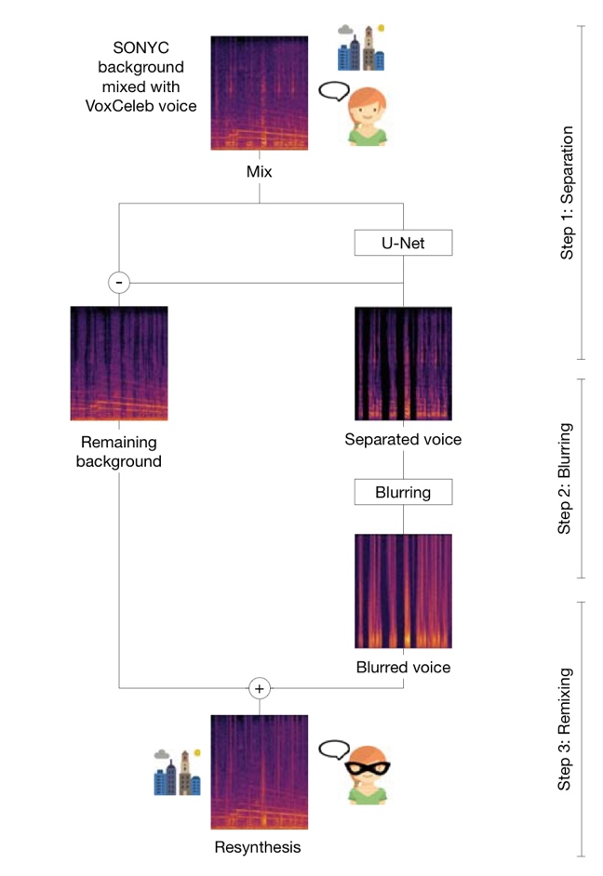
Speaker Anonymization and Content Desensitization Blur
Separation of audio signal
Extract voices from the mix of voice and background using deep neural network (U-Net), separates into 2 audio signals: the voice and the residual background
Blur Method
Blur the separated voice to remove both speaker identifiable information and obscure linguistic content.
Low pass filtering
Filter passes low frequencies and blocks high frequencies
Most of the voice content is localized to the high frequencies
Low pass filter the separated voice at 250 Hz
MFCC Inversion
Mel-frequency cepstral coefficients (MFCCs) are coefficients that collectively make up an MFC.
Compute MFCC coefficient and choose to retain only the first 5 coefficients for inversion, which is insufficient for speech recognition but still capture the general spectral envelope
Resynthesis
Recombine the blurred voice with the background signals, resulting the anonymized resynthesis

Slide 16
Content Desensitization
Replace Sensitive Keywords
Sensitive keyword determination
Personalized keywords determination: A term with higher TF-IDF(term frequency-inverse document frequency) is more likely to reveal the person’s private information
Common keywords: Collect reports from users and estimate the frequency of each word
These two methods are complementary and both should be put into use together
Using DTW-based keyword spotting to localize sensitive words
DTW ( dynamic time warping)
1. Apply DTW algorithm to calculate the distance of two signals
2. Use cosine distance of the audio’s STFT features as the distance metric
Substitute with safe words
randomized safe word substitution
split a safe word set into different categories, after the keyword is detected, determine which category the keyword belongs to, and randomly picks a safe word from that category for the substitution

Slide 17
Audio Anonymization
Consideration
Linguistic Content
Background Sound
Desensitization
Blur
Replace Word
Speaker Anonymization
Voice Conversion – PCA-GMM
Voice Conversion – CycleVAE-GAN
Voice Conversion – VTLN
Blur
Notes:
Whether we want to keep the linguistic content
Whether we want to keep the background sound

Slide 18
Audio Anonymization – Result and Comparison
Desensitization
Blur [ Successful ]
Replace Word [ Keyword Detection Accuracy 90% ]
Speaker Anonymization
Voice Conversion – PCA-GMM [ Speaker Recognition: Successful] [ WER 0.36% - 6.69% ]
Voice Conversion – CycleVAE-GAN [ Speaker Recognition 0.1-9.2%] [ Speech recognition Accuracy 78.2%-81.3%]
Voice Conversion – VTLN [ Speaker Recognition 20%] [ Speech recognition Accuracy 72%-75%]
Blur [ Speaker Recognition 29%]
Best Desensitization: Replace Word
Lowest Speaker Recognition (Best) : Voice Conversion – CycleVAE-GAN
Highest Speech Recognition Accuracy ( Lowest WER) : Voice Conversion – PCA-GMM

Slide 19
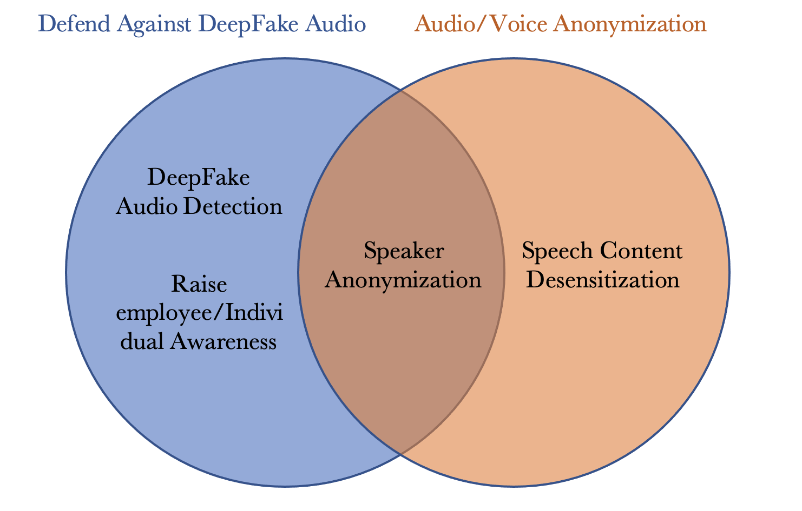
Relationship Between the Two

Slide 20

Summary
Defend DeepFake Audio
Image-Based Feature Classification
Spectro-temporal Feature
Speaker Anonymization
Voice Conversion Methods
Audio Anonymization
Consideration Factors
Linguistic Content - Speech Content Desensitization
Speaker Recognition – Speaker Anonymization
Background Acoustic Factors
Data Usage

Slide 21
References
[1] Seorg, “Deepfakes: How to defend yourself from attack,” Security Boulevard, 20-May-2020. [Online]. Available: https://securityboulevard.com/2020/05/deepfakes-how-to-defend-yourself-from-attack/.
[2] Social-Engineer, “Secure it – keep your digital profile safe from Vishers and phishers,” Social, 20-Nov-2020. [Online]. Available: https://www.social-engineer.com/secure-it-keep-your-digital-profile-safe-from-vishers-and-phishers/.
[3] J. Vincent, “Deepfake detection algorithms will never be enough,” The Verge, 27-Jun-2019. [Online]. Available: https://www.theverge.com/2019/6/27/18715235/deepfake-detection-ai-algorithms-accuracy-will-they-ever-work.
[4] K. Waddell, “Researchers are figuring out how to detect audio deepfakes before it's too late,” Axios, 03-Apr-2019. [Online]. Available: https://www.axios.com/2019/04/03/deepfake-audio-ai-impersonators.
[5] K. Waddell, “This ai-generated Ellen DeGeneres Voice is the future of deepfakes,” Axios, 03-Apr-2019. [Online]. Available: https://www.axios.com/2019/04/03/deepfake-audio-ai-ellen-degeneres.
[6] C. Franklin, “Defending against deepfakes: From tells to crypto,” Dark Reading, 17-Sep-2020. [Online]. Available: https://www.darkreading.com/edge/defending-against-deepfakes-from-tells-to-crypto.
[7] J. Khochare, C. Joshi, B. Yenarkar, S. Suratkar, and F. Kazi, “A Deep Learning Framework for Audio Deepfake Detection,” Arabian journal for science and engineering (2011), vol. 47, no. 3, pp. 3447–3458, 2021, doi: 10.1007/s13369-021-06297-w.
[8] “Precision and recall in Machine Learning - Javatpoint.” [Online]. Available: https://www.javatpoint.com/precision-and-recall-in-machine-learning.
[9] “F-score,” DeepAI, 17-May-2019. [Online]. Available: https://deepai.org/machine-learning-glossary-and-terms/f-score#:~:text=The%20F%2Dscore%2C%20also%20called,positive'%20or%20'negative'.
[10] R. Reimao and V. Tzerpos, "FoR: A Dataset for Synthetic Speech Detection," 2019 International Conference on Speech Technology and Human-Computer Dialogue (SpeD), 2019, pp. 1-10, doi: 10.1109/SPED.2019.8906599.
[11] Y. Gao, “Audio Deepfake Detection Based on Differences in Human and Machine
Generated Speech,” ProQuest Dissertations Publishing, 2022.
[12] “Equal error rate (EER) - biometric glossary,” Innovatrics, 05-May-2021. [Online]. Available: https://www.innovatrics.com/glossary/equal-error-rate-eer/.
[13] N. M. Müller, P. Czempin, F. Dieckmann, A. Froghyar, and K. Böttinger, “Does Audio Deepfake Detection Generalize?,” 2022.
[14] T. Kinnunen, K. A. Lee, H. Delgado, N. Evans, M. Todisco, M. Sahidullah, J. Yamagishi, and D. A. Reynolds, “T-DCF: A detection cost function for the tandem assessment of spoofing countermeasures and automatic speaker verification,” The Speaker and Language Recognition Workshop (Odyssey 2018), 2018.
[15] I.-C. Yoo, K. Lee, S. Leem, H. Oh, B. Ko, and D. Yook, “Speaker Anonymization for Personal Information Protection Using Voice Conversion Techniques,” IEEE access, vol. 8, pp. 198637–198645, 2020, doi: 10.1109/ACCESS.2020.3035416.
[16] H. Turner, G. Lovisotto, and I. Martinovic, “Generating identities with mixture models for speaker anonymization,” Computer speech & language, vol. 72, p. 101318–, 2022, doi: 10.1016/j.csl.2021.101318.
[17] A. Cohen-Hadria, M. Cartwright, B. McFee, and J. P. Bello, “Voice Anonymization in Urban Sound Recordings,” in 2019 IEEE 29th International Workshop on Machine Learning for Signal Processing (MLSP), 2019, pp. 1–6. doi: 10.1109/MLSP.2019.8918913.
[18] J. Qian, H. Du, J. Hou, L. Chen, T. Jung, and X.-Y. Li, “Speech Sanitizer: Speech Content Desensitization and Voice Anonymization,” IEEE transactions on dependable and secure computing, vol. 18, no. 6, pp. 2631–2642, 2021, doi: 10.1109/TDSC.2019.2960239.

